Slide 1

CS/COE 0445 - Data Structures
Spring 2018
Sherif Khattab
ksm73@pitt.edu
6307 Sennott Square
(Some slides are © 2016 Pearson Education, Ltd. All rights reserved)

Slide 2
Contact Info
Course website: http://www.cs.pitt.edu/~skhattab/cs0445/
Instructor: Sherif Khattab ksm73@pitt.edu
OH: MW 9-1pm (other times available by appointment)
Please book at http://khattab.youcanbook.me
Office: 6307 Sennott Square
Teaching Assistants
Joseph Eichorn jde32@pitt.edu (29472)
Joseph Monaco jcm132@pitt.edu (29473)
Marcus Dubreuil mld130@pitt.edu (29474)
Aaron Tamenne ajt74@pitt.edu (Grader)

Slide 3
Grades
Grading
35% exams: 25% on higher grade and 10% on lower
40% on 5 assignments (drop the lowest)
15% recitation: 2 quizzes (10%) and participation (5%)
10% lecture participation: in-class questions every lecture using Top Hat software
Assignments posted and submitted on Courseweb

Slide 4
Week 1: ADTs, Java Interfaces, Java Generics
CS/COE 0445 - Data Structures
Sherif Khattab
http://www.cs.pitt.edu/~skhattab/cs0445
(Some slide contents are © 2016 Pearson Education, Ltd. All rights reserved)

Slide 5
Contact Info
Course website: http://www.cs.pitt.edu/~skhattab/cs0445/
Instructor: Sherif Khattab ksm73@pitt.edu
OH: MW 9-1pm (other times available by appointment)
Please book at http://khattab.youcanbook.me
Office: 6307 Sennott Square
Teaching Assistants (Section 1200 TH 1pm)
Nikhilesh Singh nis80@pitt.edu (29329)
Nicholas Smider njs70@pitt.edu (29330)
Kenneth Choo kac311@pitt.edu (29331)
Mike Devine mjd73@pitt.edu (Grader)

Slide 6
Contact Info
Course website: http://www.cs.pitt.edu/~skhattab/cs0445/
Instructor: Sherif Khattab ksm73@pitt.edu
OH: MW 9-1pm (other times available by appointment)
Please book at http://khattab.youcanbook.me
Office: 6307 Sennott Square
Teaching Assistants (Section 1400 TH 4pm)
Joseph Eichorn jde32@pitt.edu (29472)
Joseph Monaco jcm132@pitt.edu (29473)
Marcus Dubreuil mld130@pitt.edu (29474)
Aaron Tamenne ajt74@pitt.edu (Grader)

Slide 7
Grading
35% exams: 25% on higher grade and 10% on lower
40% on 5 assignments (drop the lowest)
15% recitation: 2 quizzes (10%), participation (5%)
10% lecture participation: in-class questions every lecture using Top Hat software
Assignments posted and submitted on Courseweb

Slide 8
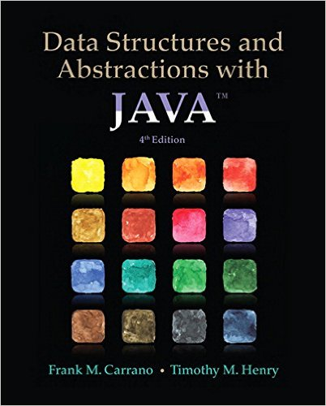
Textbook
Data Structures and Abstractions with Java (4th Edition)
Frank M. Carrano and Timothy M. Henry
(Chapters 1-10, 12-14, 18, and 23-26)

Slide 9
Response to your feedback
Good things to keep:
Using the board
Improvements:
More live code
Top Hat for engagement (hopefully!)
Java Nuggets
(10 min each lecture presented by you for bonus points ☺)
Restructured the labs
More time on generics and backtracking
Continuous feedback, please!
Feedback link on the course’s Web page

Slide 10
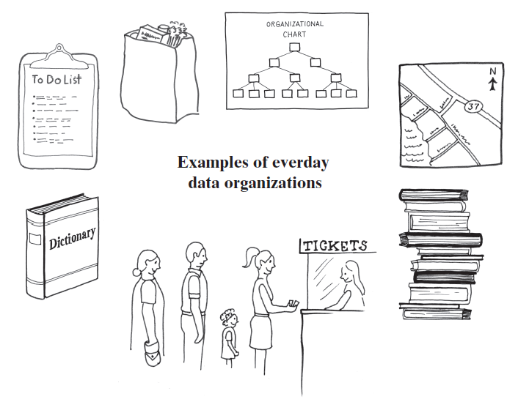
Data Organization in Life
Notes:
Standing in a line
Stack of books
To-Do list
Dictionary
Folders, directories on your computer
Road map

Slide 11
Data Organization in Computers
Abstract Data Type: ADT
Collection of data items with operations on them
Bag
List
Stack
Queue
Dictionary
Tree
Graph
Implemented by one or more Data Structures

Slide 12
Code in this Course
Client code
Code that uses ADTs
Library code
Code that implements ADTs
Use Java features to help us
Java Interfaces
Java Generics

Slide 13
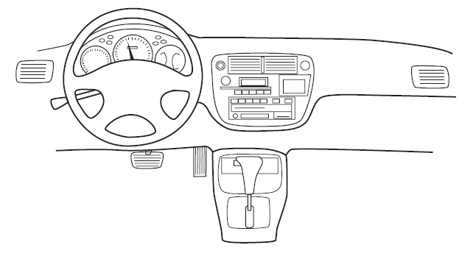
Encapsulation
Enclose data and methods within a class
Hide implementation details
Programmer receives only enough information to be able to use the class
An automobile’s controls are visible to the driver, but its inner workings are hidden

Slide 14
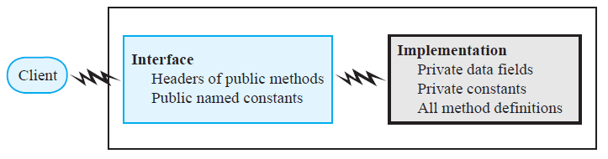
Abstraction
Focus on what instead of how
What needs to be done?
For the moment ignore how it will be done.
Divide class into two parts
Interface
provides well-regulated communication between a hidden implementation and a client
Implementation

Slide 15
Specifying Method Headers
Preconditions
What must be true before method executes
Implies responsibility for client
Postconditions
Statement of what is true after method executes
Usually about the return value(s)
Use assertions
In comments or with assert statement

Slide 16
Java Interfaces
Program component that declares a number of public methods
Should include comments to inform programmer
Any data fields here should be public, final, static

Slide 17
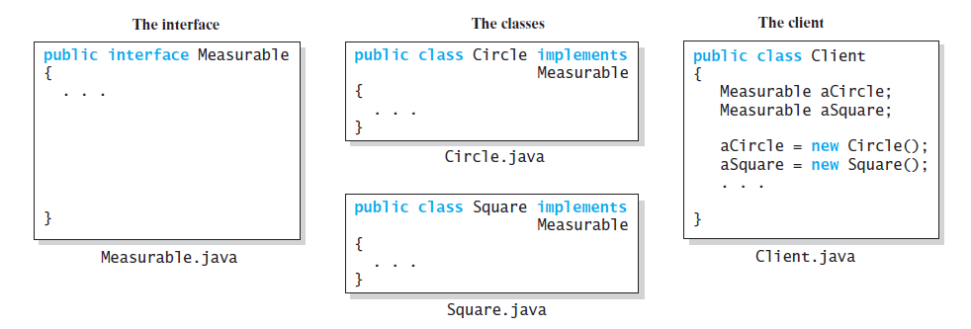
Interface vs. Implementation vs. Client
an interface, two implementations, and a client

Slide 18
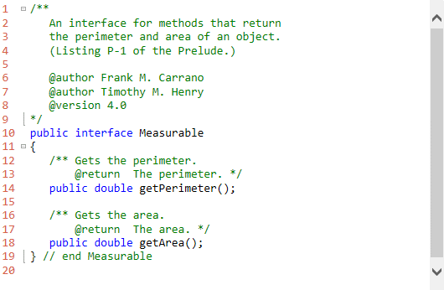
Interface Measurable

Slide 19
Implementing an Interface
A way for programmer to guarantee a class has certain methods
Several classes can implement the same interface
A class can implement more than one interface

Slide 20
Interface as a Data Type
You can use a Java interface as you would a data type
Indicates variable can invoke certain set of methods and only those methods.
An interface type is a reference type
An interface can be used to derive another interface by using inheritance

Slide 21
Abstract Classes and Methods
An abstract class will be the superclass of another class
Thus, an abstract class is sometimes called an abstract superclass.
Declare abstract method by including reserved word abstract in header

Slide 22
Abstract Classes and Methods
Abstract method cannot be private, static, or final.
Class with at least one abstract method must be declared as an abstract class
Abstract methods can appear only within an abstract class.
Constructors cannot be abstract

Slide 23
Interface vs. Abstract Class
Purpose of interface similar to that of abstract class
But an interface is not a class
Use an abstract class …
If you want to provide a method definition
Or declare a private data field that your classes will have in common
A class can implement several interfaces but can extend only one abstract class.

Slide 24
Named Constants Within an Interface
An interface can contain named constants,
Public data fields that you initialize and declare as final.
Options:
Define the constants in an interface that the classes implement
Define your constants in a separate class instead of an interface

Slide 25
Generic Data Types
Enable you to write a placeholder instead of an actual class type
The placeholder is
A generic data type
A type parameter
You define a generic class
Client chooses data type of the objects in collection.

Slide 26
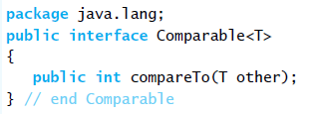
The Interface Comparable
By invoking compareTo, you compare two objects of the class T.
Negative this < other
Zero if this and other are equal
Positive if this > other

Slide 27
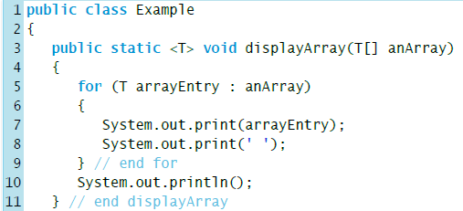
Generic Methods

Slide 28
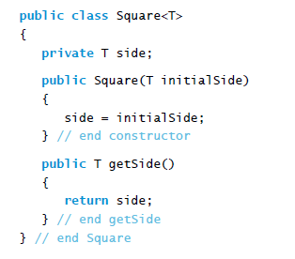
Bounded Type Parameters
Consider this simple class of squares:

Slide 29
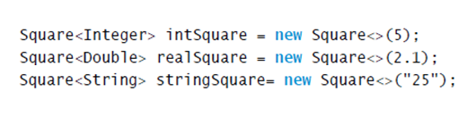
Bounded Type Parameters
What is wrong here?

Slide 30
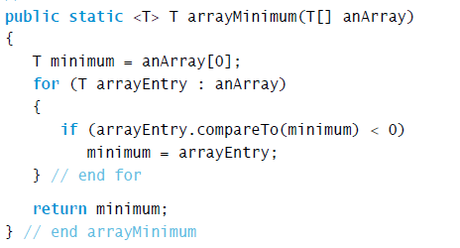
Bounded Type Parameters
Imagine that we want to write a static method that returns the smallest object in an array. Suppose that we wrote our method shown above

Slide 31
Bounded Type Parameters
Header really should be as shown

Slide 32
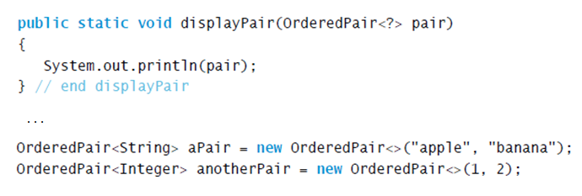
Wildcards
Question mark, ?, is used to represent an unknown class type
Referred to as a wildcard
Method displayPair will accept as an argument a pair of objects whose data type is any one class

Slide 33
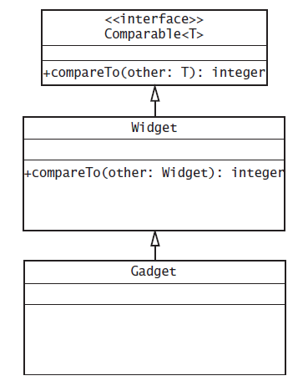
Bounded Wildcards
The class Gadget is derived from the class Widget, which implements the interface Comparable

Slide 34
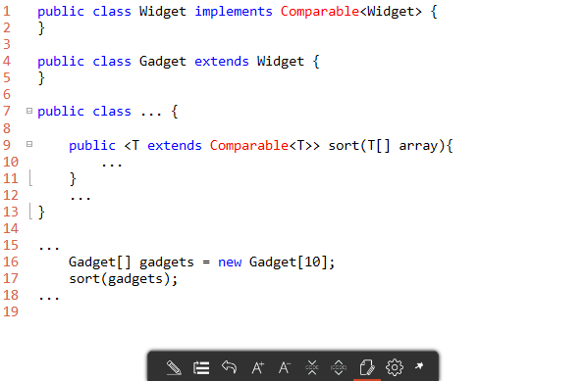

Slide 35
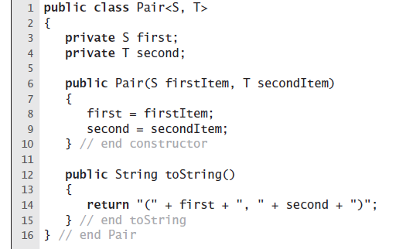
More Than One Generic Type

Slide 36
Miscellaneous Features

Slide 37
Composition
A class uses composition when it has a data field that is an instance of another class
Composition is a “has a” relationship
Consider a class of students, each has
A name, an identification number.
Thus, class Student contains two objects as data fields:
An instance of the class Name
An instance of the class String:

Slide 38
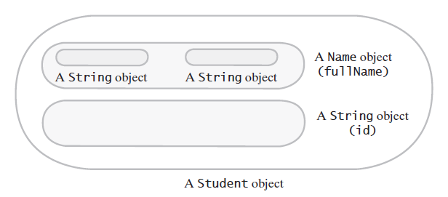
Composition
FIGURE D-1 A Student object is composed of other objects
© 2015 Pearson Education, Inc., Upper Saddle River, NJ. All rights reserved

Slide 39
Invoking Constructors from Within Constructors
Constructors typically initialize a class’s data fields
To call constructor of superclass explicitly.
Use super( ) within definition of a constructor of a subclass
If you omit super( )
Constructor of subclass automatically calls default constructor of superclass.

Slide 40

Invoking Constructors from Within Constructors
Also possible to use this to invoke constructor of superclass

Slide 41
Overriding and Overloading Methods
When a subclass defines a method with
the same name
the same number and types of parameters
and the same return type as a method in the superclass …
Then definition in the subclass is said to override the definition in the superclass.
You can use super in a subclass to call an overridden method of the superclass.

Slide 42
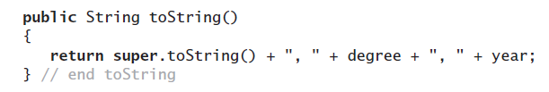
Overriding and Overloading Methods
Possible to new method invoke the inherited method
Need to distinguish between the method for subclass and method from superclass

Slide 43
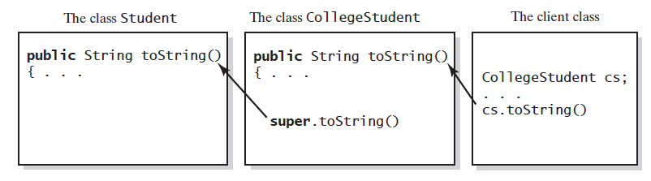
Overriding and Overloading Methods
FIGURE D-4 The method toString in CollegeStudent overrides the method toString in Student

Slide 44
The Class Object
Java has a class—named Object
It is at the beginning of every chain of subclasses
An ancestor of every other class
Class Object contains certain methods
Examples: toString, equals, clone
However, in most cases, you must override these methods

Slide 45
The Class Object
Inherited version of toString returns value based upon invoking object’s memory address.
Need to override the definition of toString
Cause it to produce an appropriate string for data in the class being defined

Slide 46
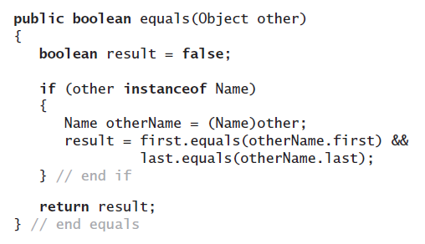
The Class Object
Object’s equals method compares the addresses of two objects
Overridden method, when added to the class Name, detects whether two Name objects are equal by comparing their data fields:

Slide 47
The Class Object
Class Object method clone.
Takes no arguments and returns a copy of the receiving object
We will need to override this method
Discussion of the method clone appears in Java Interlude 9.

Slide 48
Overriding and Overloading Methods
When subclass has a method with same name as a method in its superclass,
but the methods’ parameters differ in number or data type …
Method in subclass overloads method of superclass.
Java is able to distinguish between these methods
Signatures of the methods are different

Slide 49
Overriding and Overloading Methods
Possible to call an overridden method of the superclass by prefacing the method name with super and a dot.
But … repeated use of super is not allowed

Slide 50
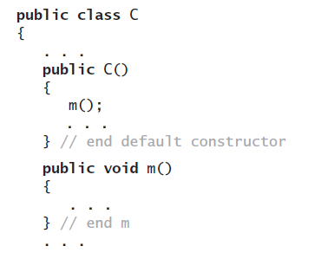

Overriding and Overloading Methods
To specify that a method definition cannot be overridden with a new definition in a subclass
Make it a final method by adding the final modifier to the method header.

Slide 51
Multiple Inheritance
Some programming languages allow one class to be derived from two different superclasses
This feature not allowed in Java.
In Java, a subclass can have only one superclass

Slide 52
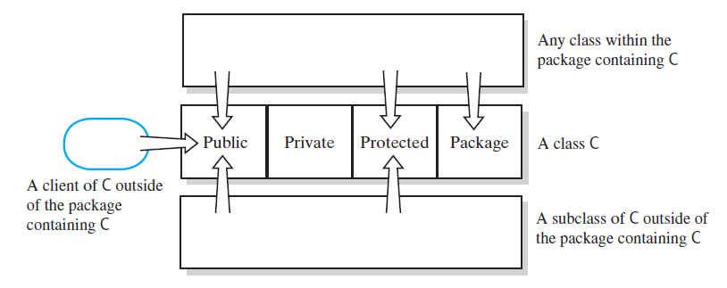
Access Modifiers
Public, private, protected, and package access of the data fields and methods of class C

Slide 53
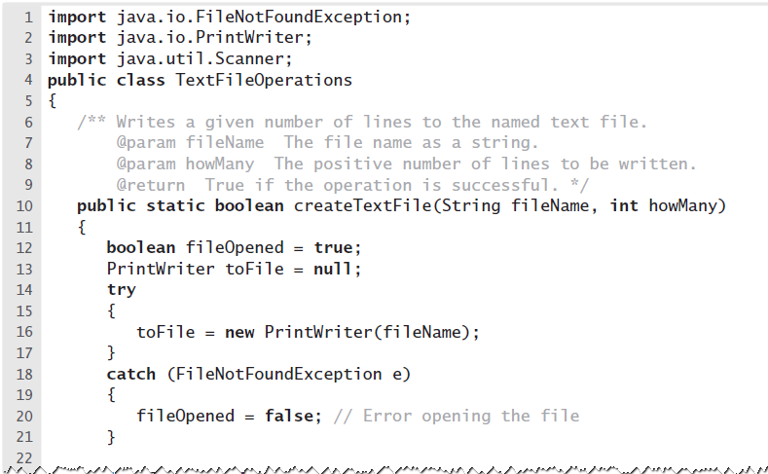
Writing to a Text File
LISTING E-1 The static method createTextFile in the class TextFileOperations

Slide 54
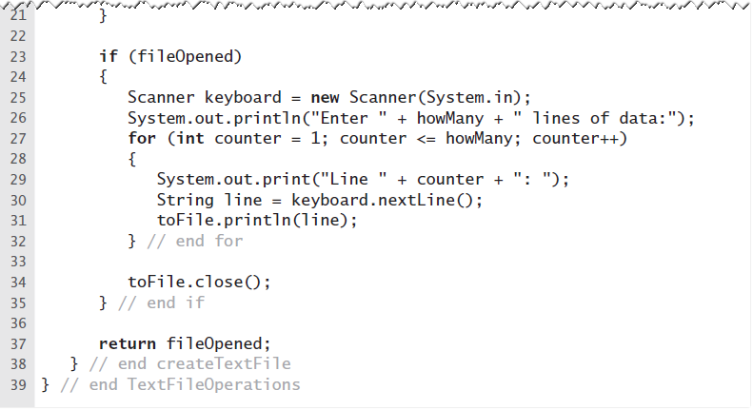
Writing to a Text File
LISTING E-1 The static method createTextFile in the class TextFileOperations

Slide 55
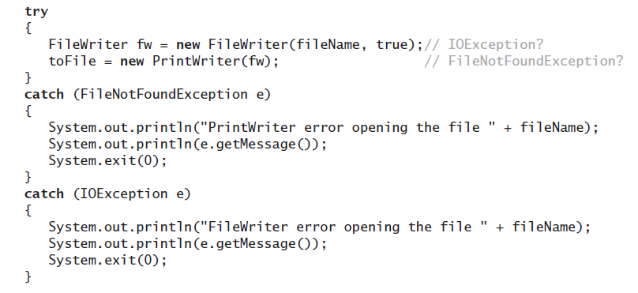
Appending to a Text File
Opening file with try and catch

Slide 56
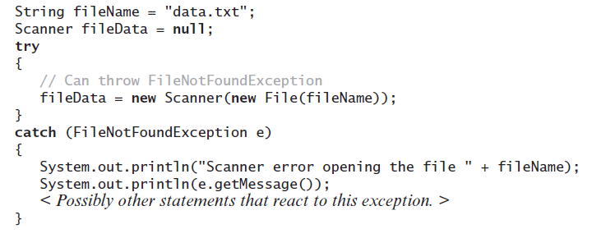
Reading a Text File
Opening the text file named data.txt for input

Slide 57
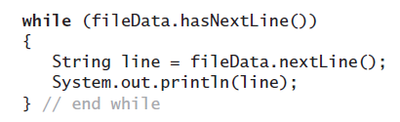
Reading a Text File
If you do not know format of the data in file,
Use the Scanner method nextLine to read it line by line.

